Slide 1
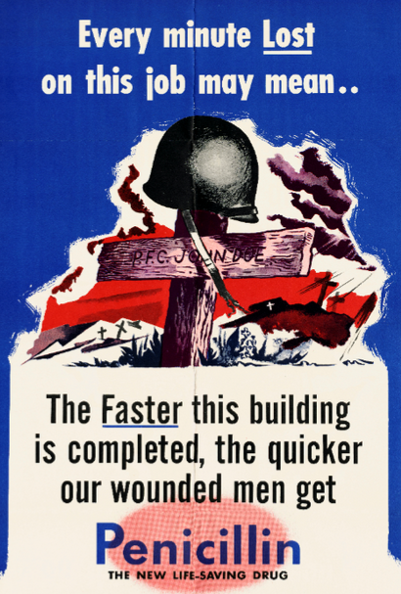
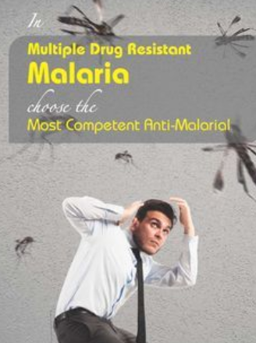
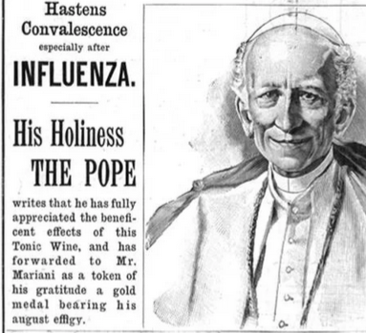

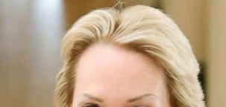
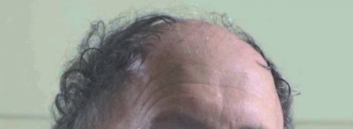
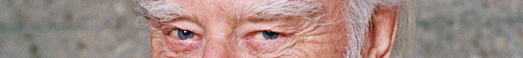
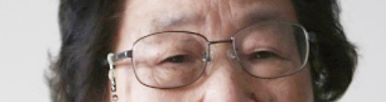
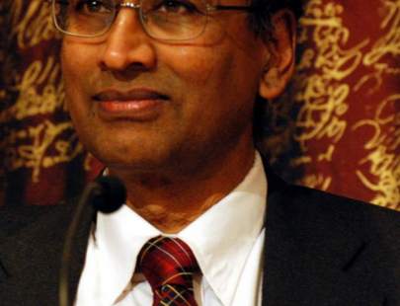
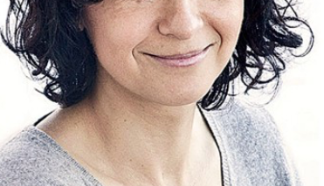
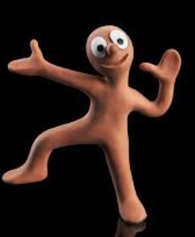
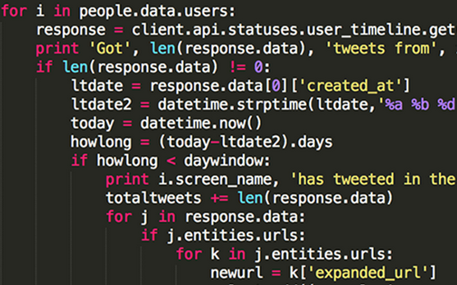
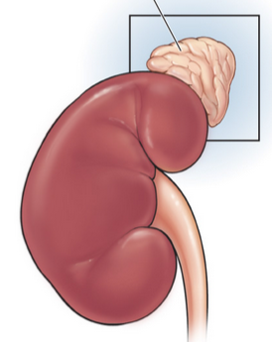
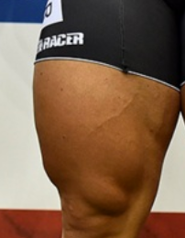
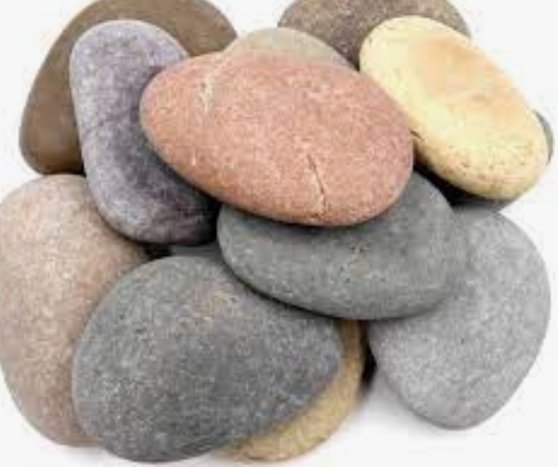
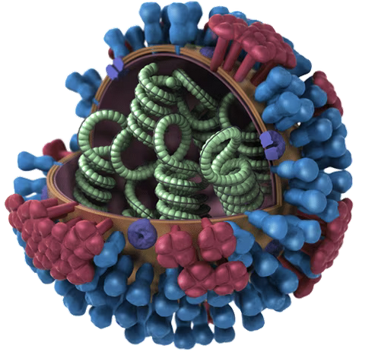
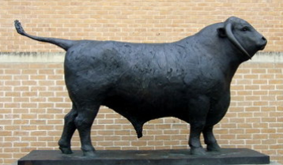
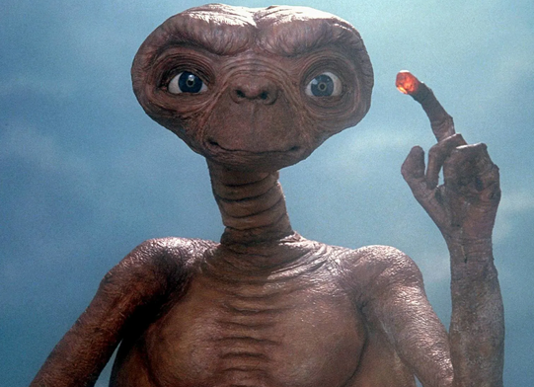
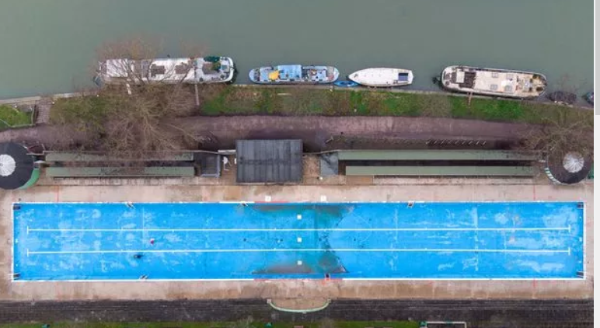
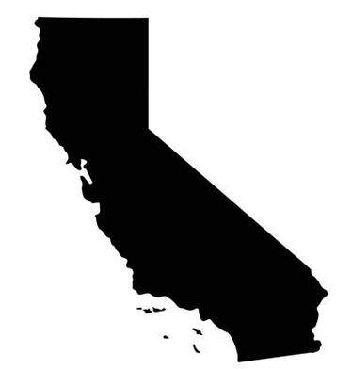
Pharmacology Industry Engagement Day pub-quiz 2024
Please form teams of maximum 6 people with a mixture of industry and academia. Come up with a fun team name.
TEAM NAME:
............................................................................................................................
Write your answers next to the questions and we will provide answers at the end.
1. Customer knows best. Which drug is advertised? (generic or brand-name OK)
(a) (b) (c) (d)
2. Give the full name of each Nobel-winning biologist shown.
3. Find the most surprising thing that two members of your team have in common.
4. Catchphrase/Dingbats: Deduce the drug ending in -ine based on the clues.
(a) (b) (c) (d)
(e) (f)
5. Your team has discovered a highly effective drug against
male-pattern baldness. Come up with the best drug brand-name.
_ _ _ _ _ _ _
_ _ _ _ _ _
HA
NA
Notes:
Pope Leo XIII 1878-1903(Mariani also popular with Thomas Edison)

